Slide 1
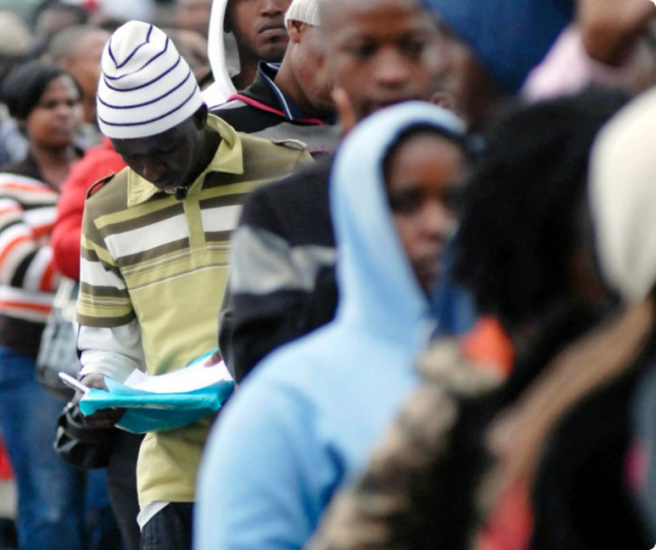
Unraveling the Challenges of Unemployment in Africa:
A Data-Driven Approach
10Alytics Global Hackathon 2023
2 – 3 December 2023

Slide 2

Introduction

Slide 3
Introduction
General Overview
Unemployment remains one of the most daunting challenges facing African nations today. It is a multifaceted problem with deep roots in socio-economic, educational, and policy-related factors. This case study invites analysts and policymakers to delve into various datasets to uncover insights and strategies that could assist in mitigating the unemployment crisis in Africa.
Objective
The primary goal of this case study is to analyze data, identify patterns, and propose informed, data-driven recommendations that governments and stakeholders can implement to effectively address and reduce unemployment rates, particularly focusing on the African context.
Expected Outcomes
Participants are expected to:
Understand the multi-dimensional nature of unemployment in Africa.
Identify key factors contributing to high unemployment rates.
Propose data-driven solutions and strategies that can be adopted by governments and other stakeholders.
Draw meaningful insights and correlations through data visualization techniques.
We encourage participants to approach this case study with creativity, analytical rigor, and a focus on practical, implementable solutions. The insights derived from this analysis have the potential to inform policy, shape educational and economic strategies, and ultimately contribute to the reduction of unemployment in Africa.
Data Overview
Participants will engage with six diverse datasets, each offering a unique perspective on factors influencing unemployment:
Unemployment Rate (Men vs. Women): This dataset provides a comparative view of unemployment rates between genders.
National Strategy for Youth Employment: This dataset outlines various national strategies adopted across different African countries to combat youth unemployment.
Share of Education in Government Expenditure: Education is a critical factor in employment. This dataset sheds light on how much governments are investing in education.
Population with Access to Electricity: Access to electricity is a fundamental driver of economic development and can influence employment opportunities. This dataset provides insights into the availability of electricity across different regions and its potential impact on employment.
Total Firms (Historical Data): The health of a country's private sector is directly linked to employment rates. This dataset includes historical data on the number of firms.
Country Codes: This dataset is essential for mapping data points to specific African countries, enabling a more precise and geographically contextual analysis.

Slide 4
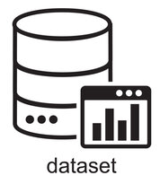
Datasets
Download Datasets HERE

Slide 5
Datasets
There are four (6) datasets for this project. The data dictionary containing the features of the data can be found in Slides 7 - 12
1
Unemployment Rate by Gender
2
National Strategy for Youth Employment
3
Share of Education in Government Expenditure
4
Share of the Population with Access to Electricity
5
Total Number of LLCs from 2006 - 2020
6
Country Code

Slide 6
Data Dictionary

Slide 7
Data Dictionary
1. Unemployment Rate by Gender
Fields | Description
Entity | This field represents the country or region.
Code | A three-letter code representing the country where the unemployment data was collected. This column is a categorical variable.
Year | The Year when the Unemployment rate data was collected
Unemployment, female (% of female labor force) (modeled ILO estimate) | This represents the percentage of the female labor force that is unemployed, as estimated by the International Labour Organization (ILO).
Unemployment, male (% of male labor force) (modeled ILO estimate) | This represents the percentage of the male labor force that is unemployed, based on ILO estimates.
Population (historical estimates) | This column contains the population figures for the respective entity for the given year
Continent | This field indicates the continent where the entity (country or region) is located.

Slide 8
Data Dictionary
2. National Strategy for Youth Employment
Fields | Description
Entity | This field represents the country or region.
Code | A three-letter code representing the country where the data was collected. This column is a categorical variable.
Year | The Year when the data was collected
8.b.1 - Existence of a developed and operationalized national strategy for youth employment, as a distinct strategy or as part of a national employment strategy - SL_CPA_YEMP | This field indicates the status of a national strategy for youth employment in the respective country. 0: No Strategy 1: Developing a Strategy 2: Strategy Adopted 3: Strategy Operationalized

Slide 9
Data Dictionary
3. Share of Education in Government Expenditure
Fields | Description
Entity | This field represents the country or region.
Code | A three-letter code representing the country where the data was collected. This column is a categorical variable.
Year | The Year when the data was collected
Government expenditure on education, total (% of government expenditure) | This represents the percentage of total government expenditure that is allocated to education. This field measures the priority given to education in the national budgets of the respective entities.

Slide 10
Data Dictionary
4. Share of the Population with Access to Electricity
Fields | Description
Entity | This field represents the country or region.
Code | A three-letter code representing the country where the data was collected. This column is a categorical variable.
Year | The Year when the data was collected
Access to electricity (% of population) | This represents the percentage of population with access to electricity

Slide 11
Data Dictionary
5. Total Number of LLCs from 2006 - 2020
Fields | Description
Economy | This field represents the country or region.
Adult Population | The number of adults in the specified economy
Year | The Year when the data was collected
Number of LLCs | This field indicates the number of new limited liability companies (LLCs) that were registered in the specified economy in the given year. This is a measure of entrepreneurial activity and business creation.
New Business Density Rate | The number of registered firms per 1,000 working-age people (those ages 15–64). The units of measurement are private, formal sector companies with limited liability

Slide 12
Data Dictionary
6. Country Code
Fields | Description
Name | The name of the country. This column is a categorical variable.
Alpha-2 | This is the two-letter country code, which is part of the ISO 3166 standard
Alpha-3 | This is the three-letter country code, also part of the ISO 3166 standard.
Country-code | This is a numeric country code, again as defined in ISO 3166.
Region | The general geographical region in which the country is located (e.g., Asia, Europe, Africa, Oceania, Americas)
Sub-region | A more specific geographical region categorization (e.g., Southern Asia, Northern Europe).

Slide 13
Tools & Presentation Criteria

Slide 14






Tools & Presentation Criteria
Tools to be used
Participants are free to use any visualization or analytical tool they prefer for analyzing the data in the case study.
Here are some examples of tools that can be used:
Data analysis: Excel, R, Python, SAS, Stata, SPSS
Data visualization: Tableau, Power BI, QlikView, ggplot2 (in R)
Presentation Criteria
Participants are free to use any tool to present their findings in the hackathon.
Here are some examples of tools that can be used for the presentation:
PowerPoint
Excel
Power BI
Tableau
Python
etc

Slide 15

Tools & Presentation Criteria
Presentation Criteria
Data Analysis: How well did the participant analyze the provided data? Were their findings insightful and relevant? Did they use appropriate statistical methods?
Visualizations:
Did the participant create clear and visually appealing data visualizations? Did they use the right types of charts and graphs to communicate their findings?
Interpretation:
Did the team effectively interpret their findings? Did they draw appropriate conclusions and insights from the data?
Creativity:
Did the participant approach the problem with a creative and innovative mindset? Did they think outside the box in their analysis and presentation?
Clarity:
Was the presentation clear and easy to understand? Did the participant communicate their findings effectively and concisely?
Impact:
Did the participant findings have a significant impact on the problem at hand? Did they provide valuable insights and recommendations for key stakeholders?
Technical Ability:
How well did the participant use the tools and technologies at their disposal? Were their methods sound and effective?
Area of Concentration
Provide your recommendation to the case study
Include the limitations of the dataset and how you think your analysis can be further enriched
Be ready to discuss your insights and share what you learned working on the datasets
All the best!!

